Slide 1



@eXigentCoder
@DesolationJakey
JSinSpace
Notes:
Intro for Jake & I
Who we are, why we like KSP

Slide 2
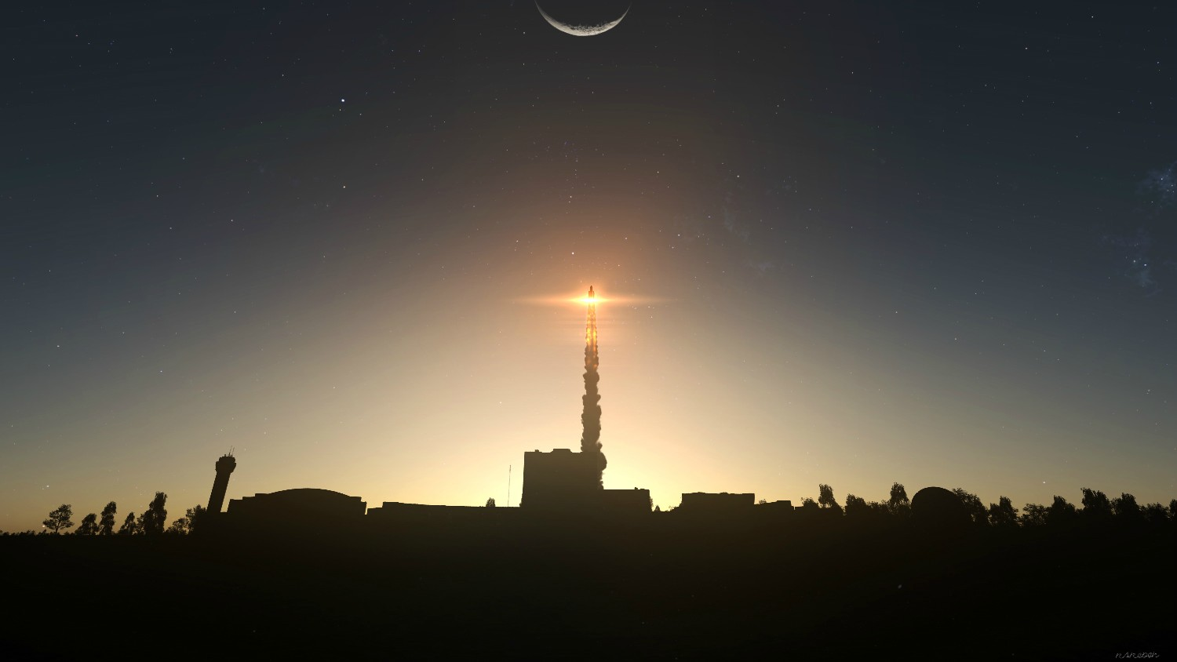
Notes:
KSP puts you in command of your very own space program, housed at the KSC on the planet Kerbin

Slide 3
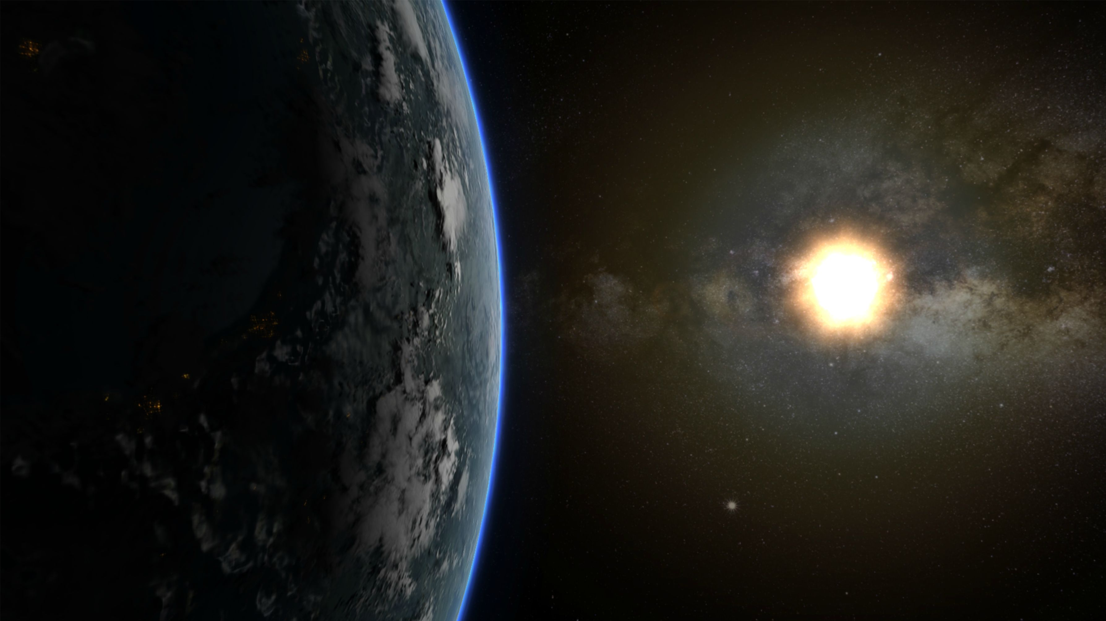
Notes:
Kerbin is an earth like planet, with the same gravity but a much smaller radius

Slide 4
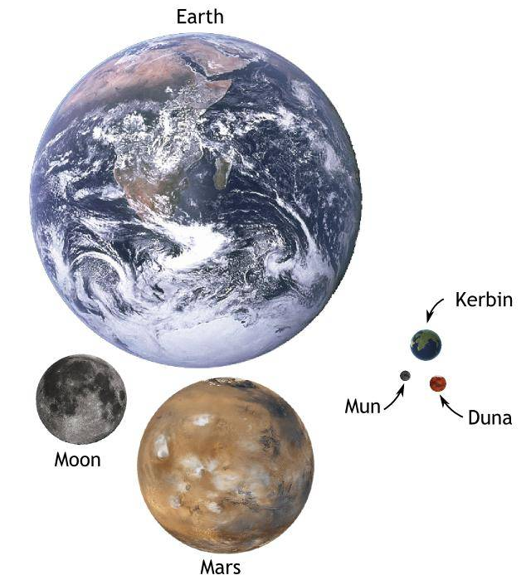
http://imgur.com/gallery/ckadxCa
Notes:
Here you can actually see how much smaller it is, Roughly 10.9 times smaller
Gameplay - (10min to LEO)
Technical - floating point errors
Kerbin is populated by a race of “little green men”, called Kerbals

Slide 5
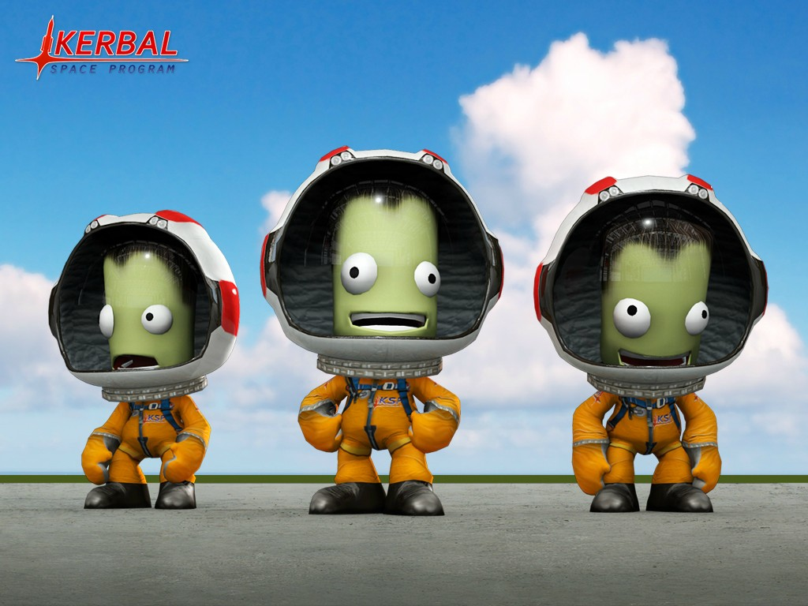
Notes:
The most famous of all kerbals is a Kerbonaut named Jebediah Kerman
Here you can see Jeb with his fellow two explorers, Bill and Bob
Kerbals have only got two important statistics, Bravery and Stupidity

Slide 6
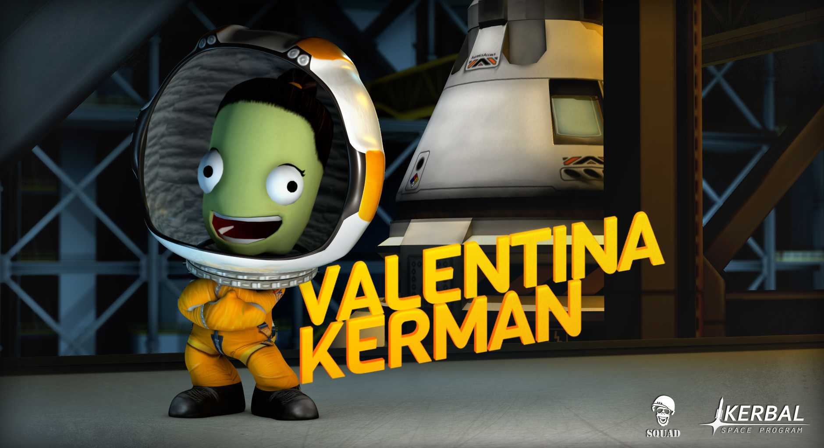
Notes:
And the latest, very important Kerbal!

Slide 7
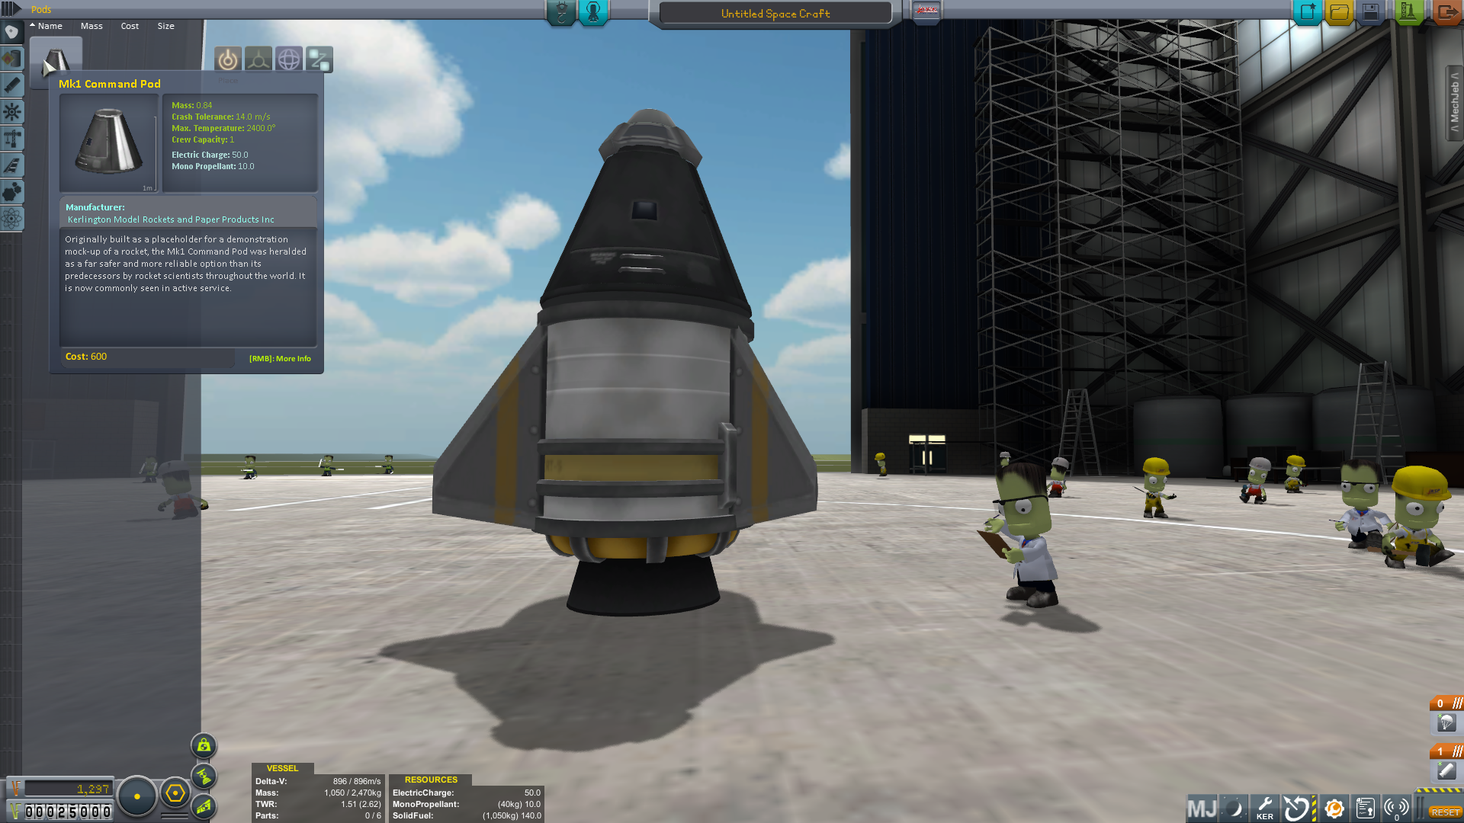
Notes:
Build your ship from parts, using funds

Slide 8
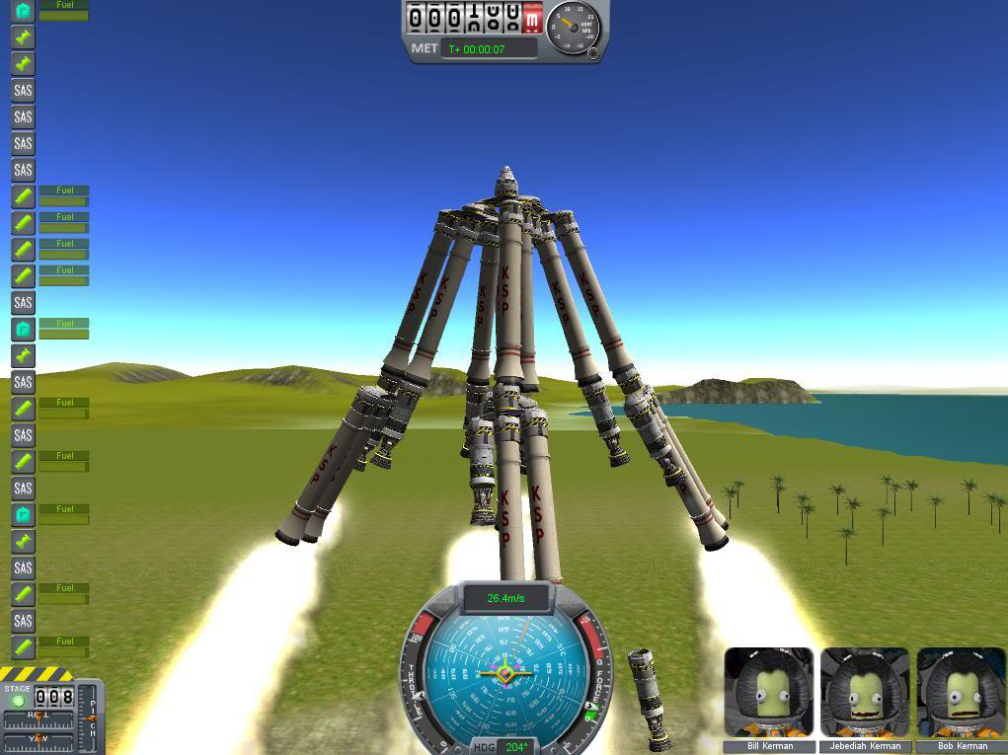
Notes:
You can build some strange and interesting craft

Slide 9
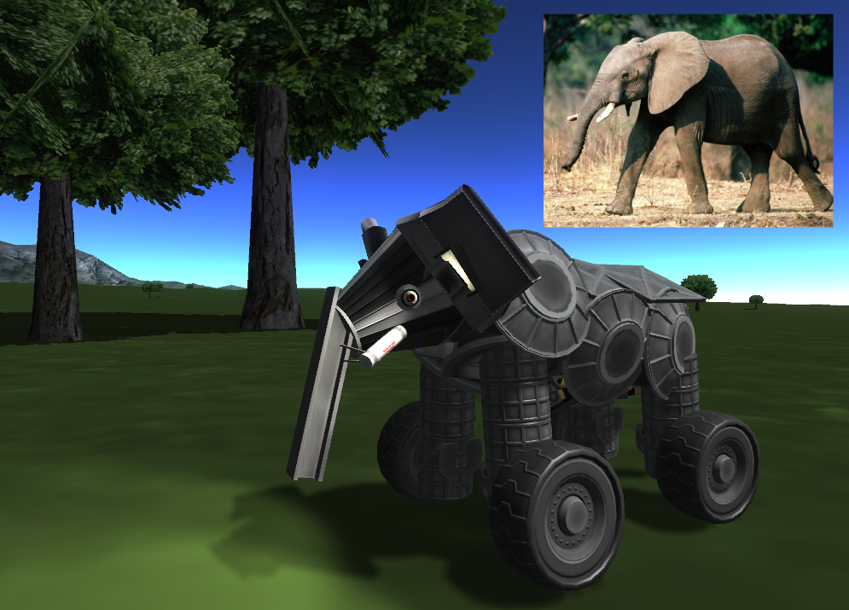
Notes:
Really strange.

Slide 10
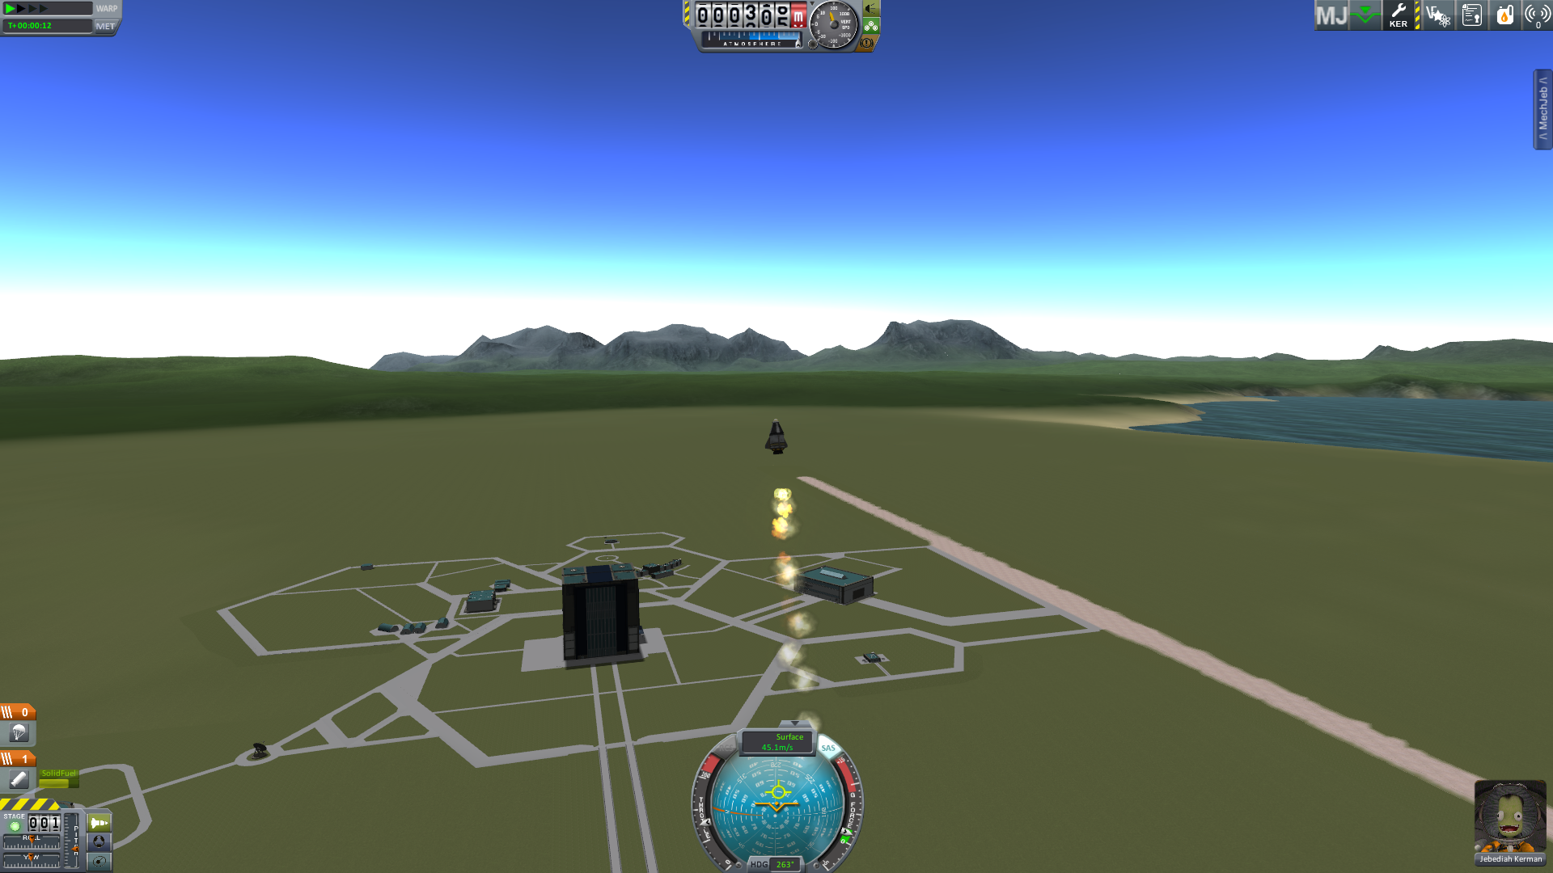
Notes:
Launch the missions

Slide 11
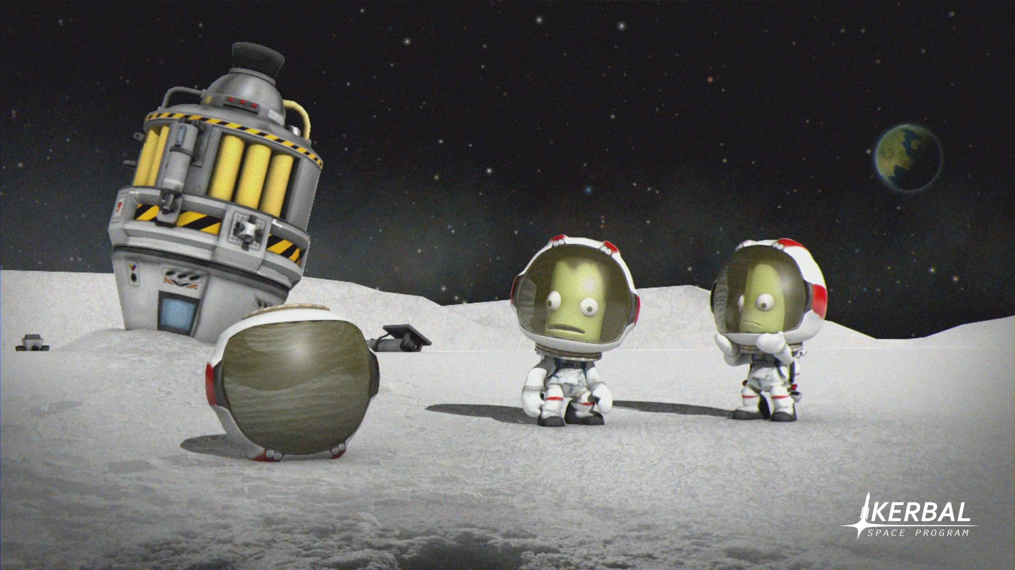
Notes:
Visit new places and have new experiences

Slide 12
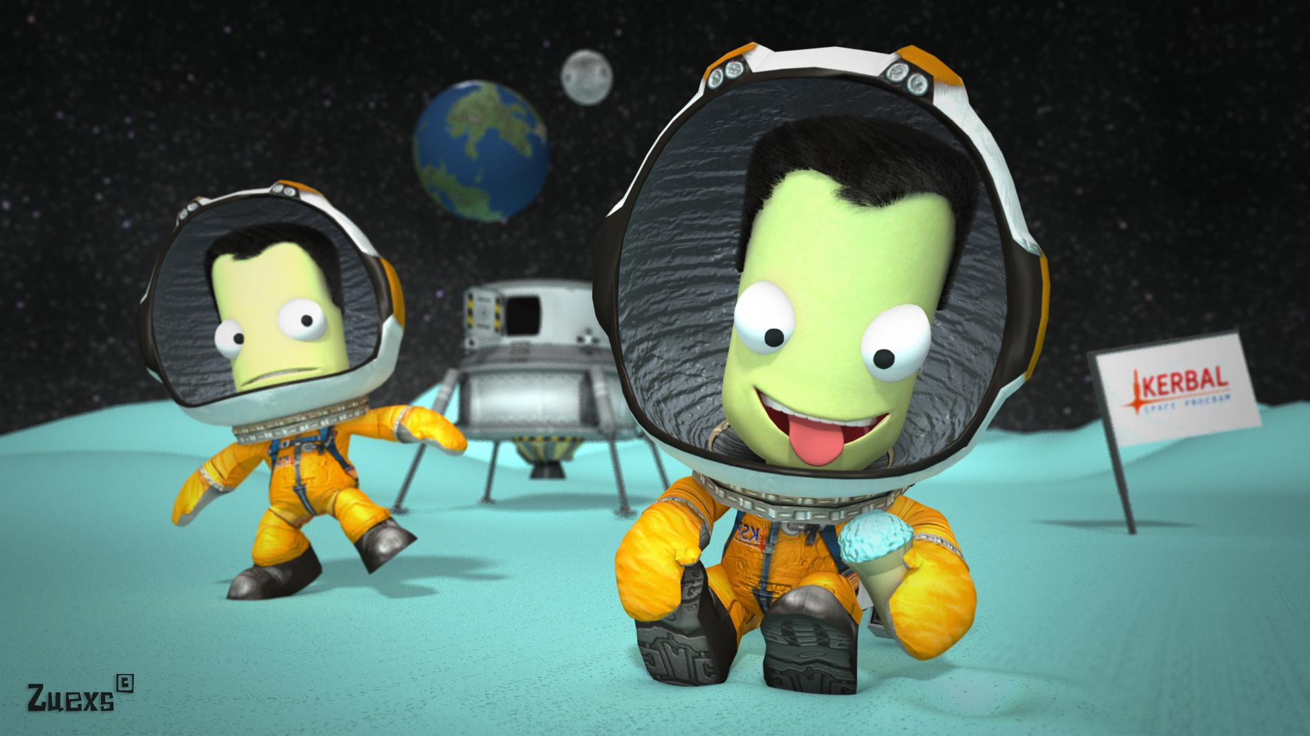
Notes:
Do some scientific tasting … I mean testing

Slide 13
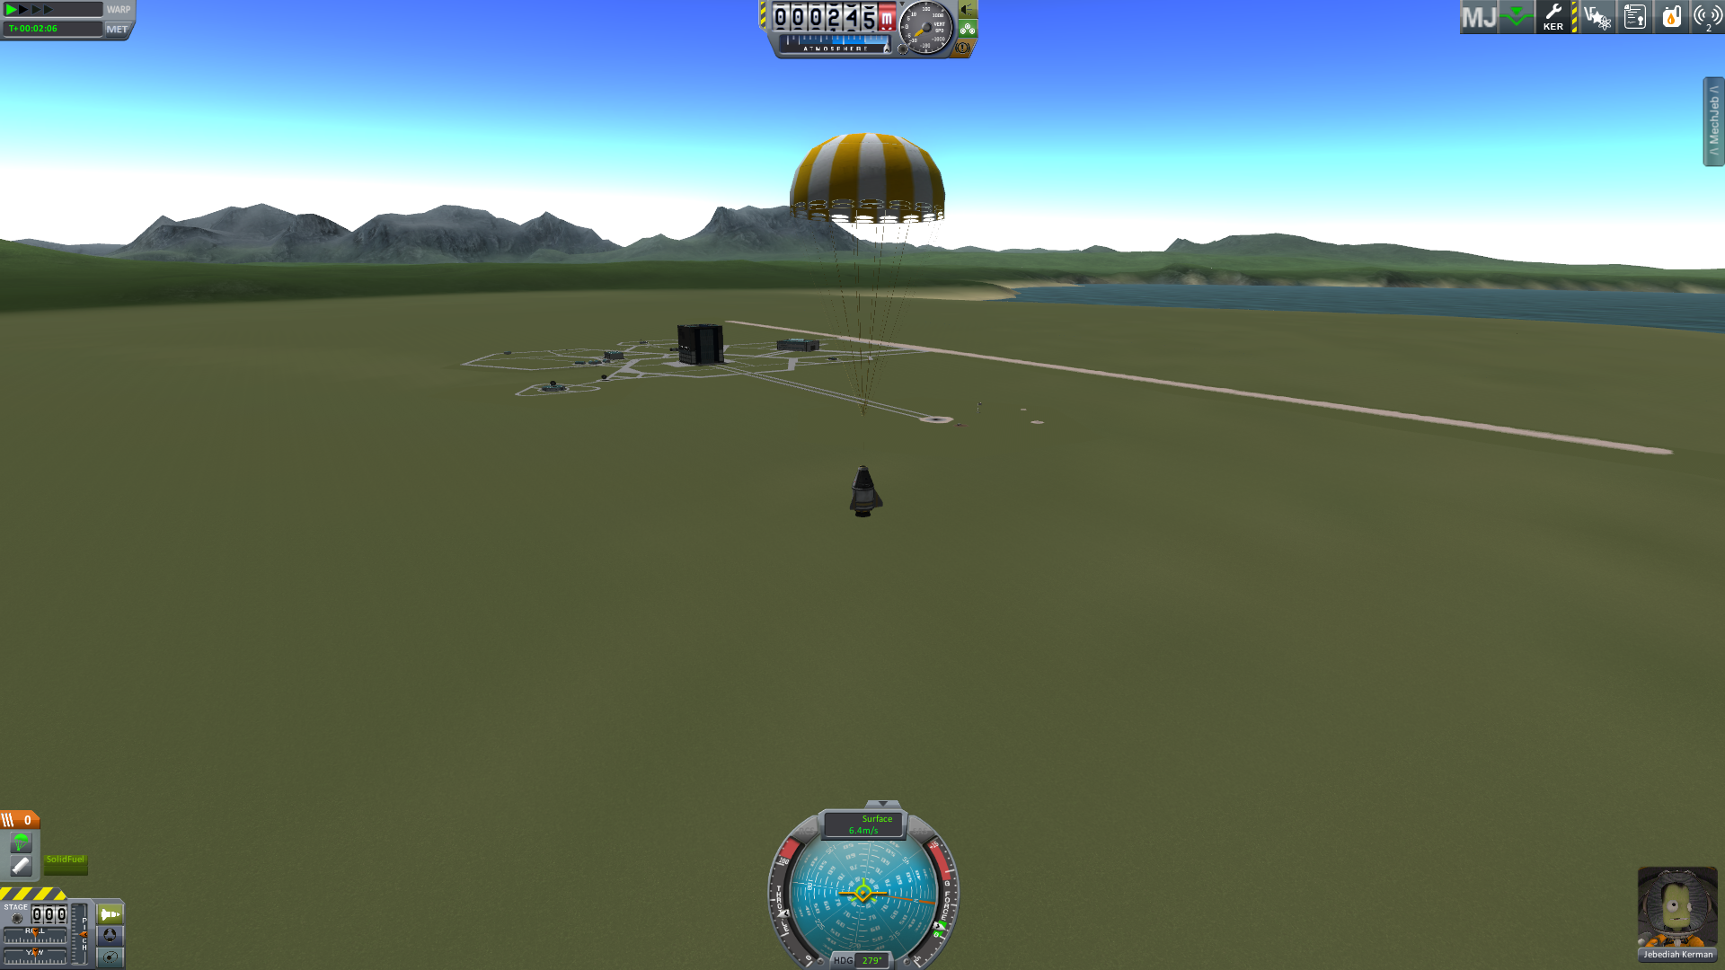
Notes:
Ideally recover your ship, loaded with all that tasty science and of course the pilot.
This step, while useful, is completely optional, given the expendable nature of kerbals and the endless supply of fresh, eager kerbonauts.

Slide 14
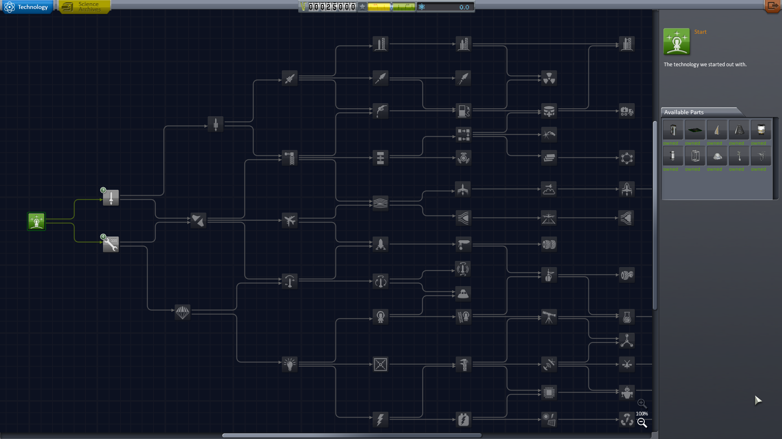
Notes:
You can then use that recovered science to research new parts

Slide 15
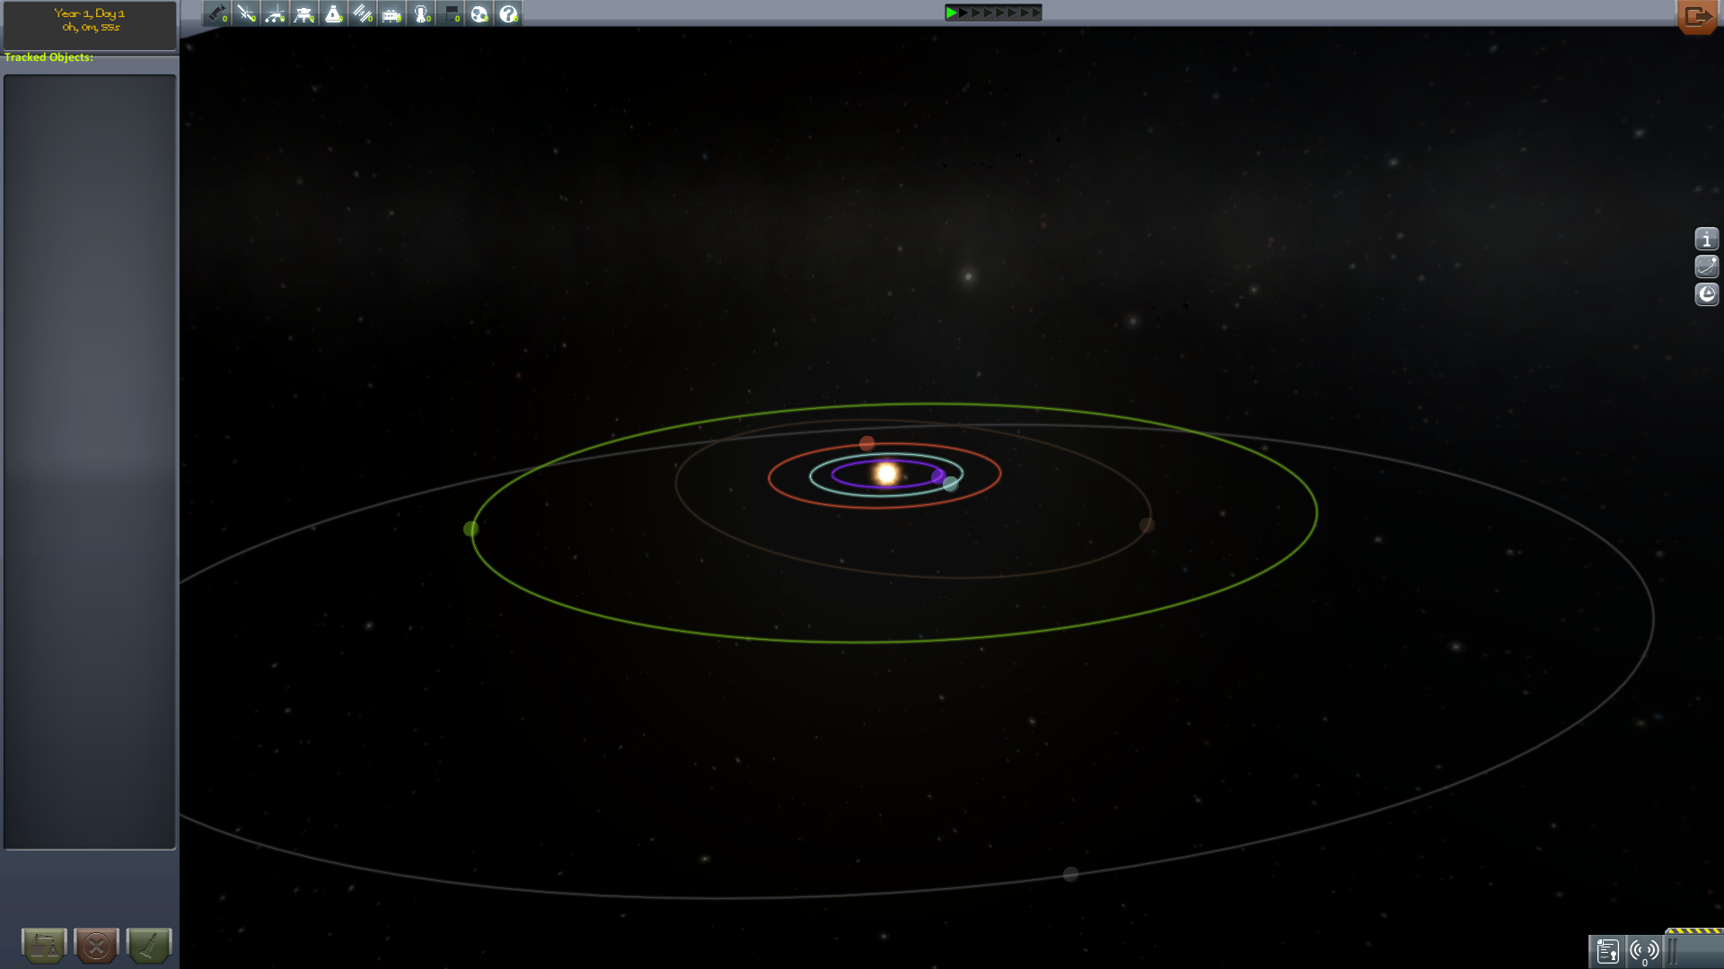
Notes:
These new parts will allow you to go out and explore the rest of the solar system

Slide 16
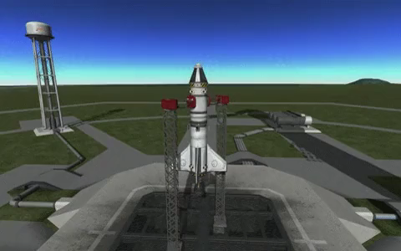
Notes:
The game also has a sandbox mode, where you can do pretty much anything..

Slide 17

Notes:
Developed by Squad
Written in C# using Mono together with Unity game engine
Currently supports Windows, OSX and Linux.
Currently being ported to PS4, Xbox One and Wii U
Lots of support for mods
Keyboard, mouse, gamepad and joystick input
Oculus rift support

Slide 18
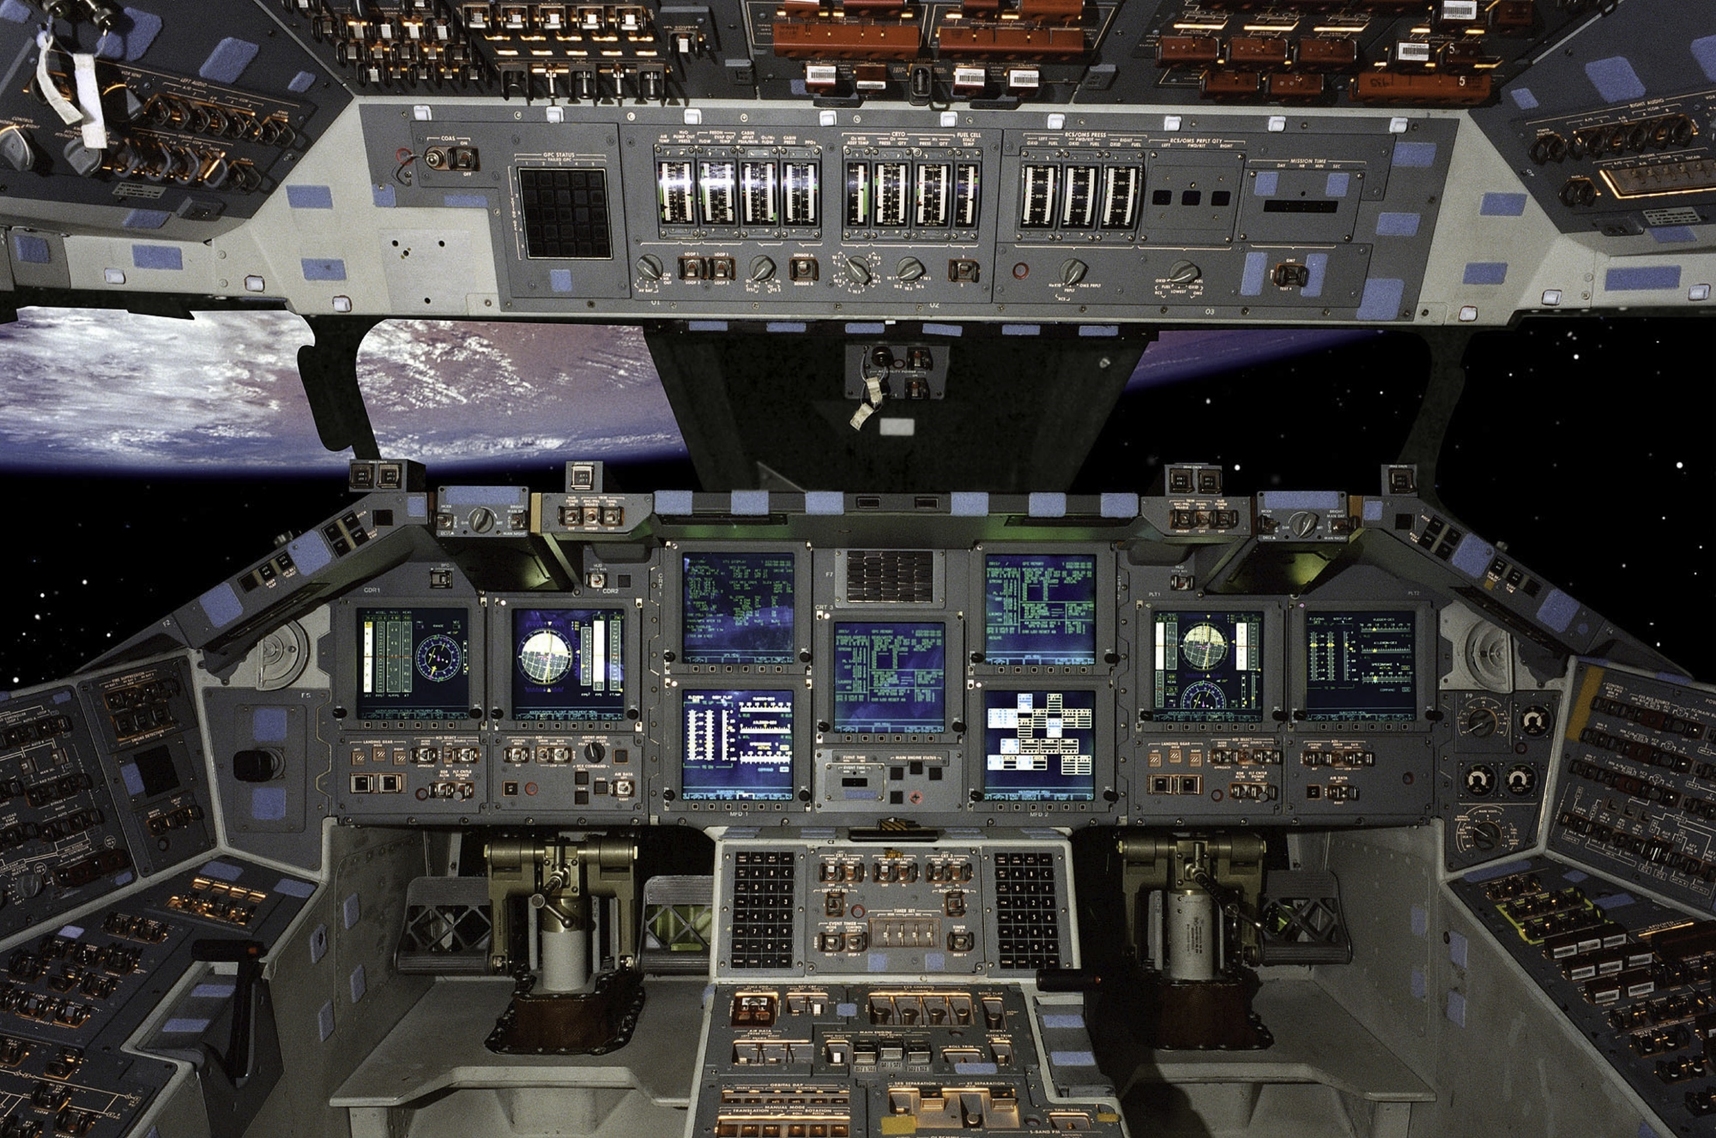
Notes:
Wanted to create a better way to control our space ships. This is a Space Shuttle Cockpit, it has lots of button dials, and of course an auto-pilot.

Slide 19
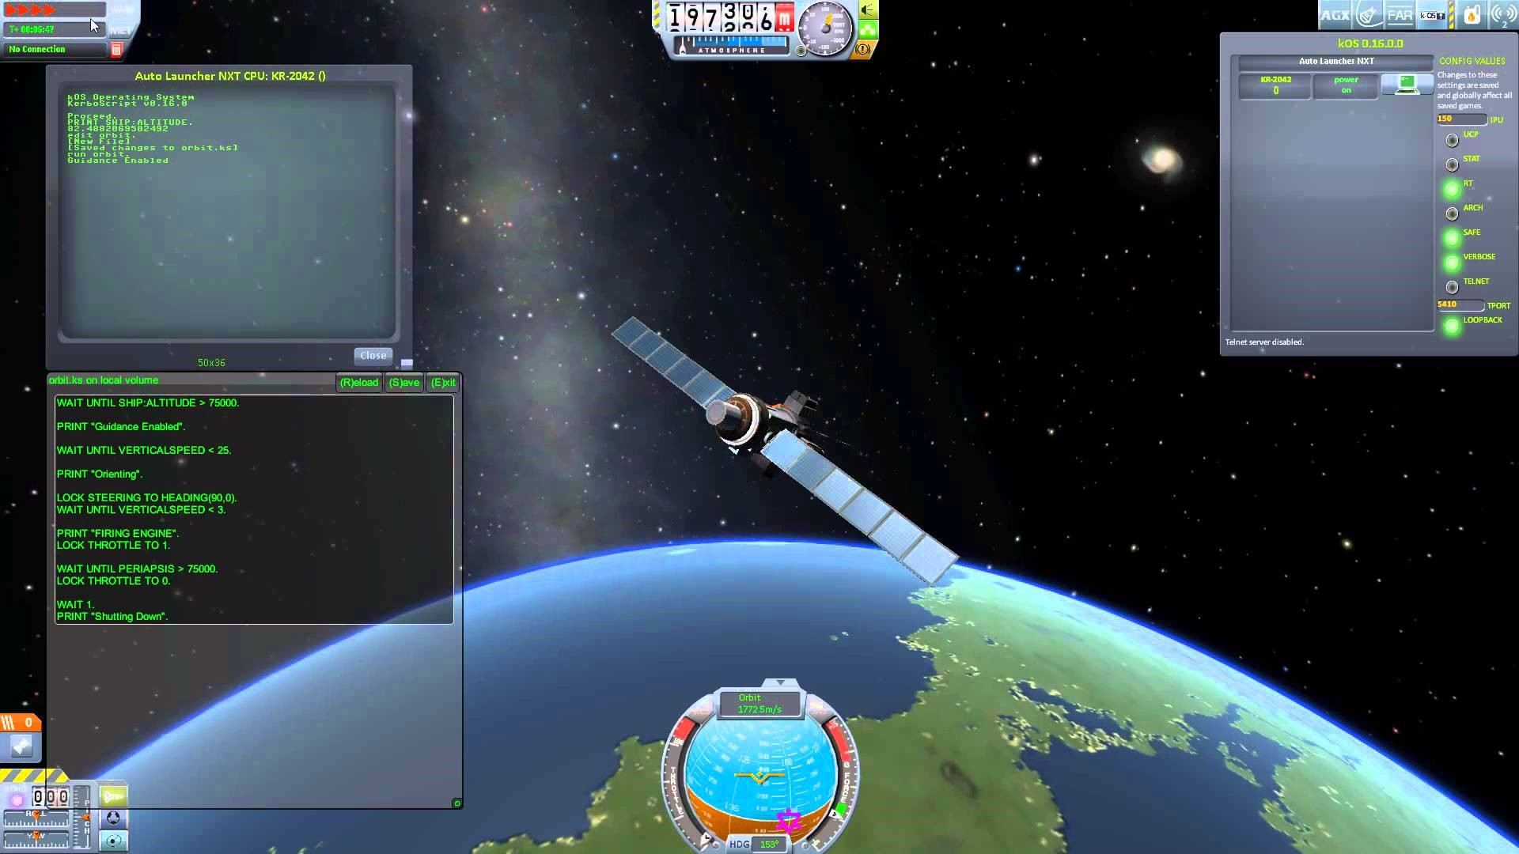
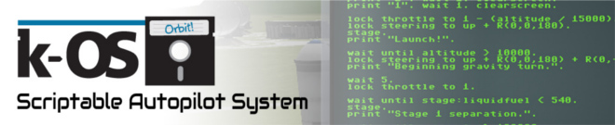
Notes:
The first way to interact with the game was via K-os. It allows you to write, save and execute automated scripts from inside the game itself.
Language based on Kerbal stupidity so not too great!

Slide 20
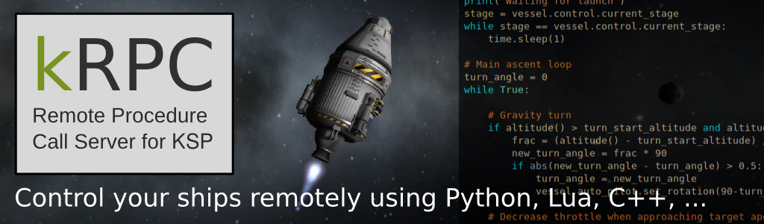
Notes:
Lastly we looked at kRPC, it had most of what I needed but they didn’t have a JavaScript client. So we built one…

Slide 21
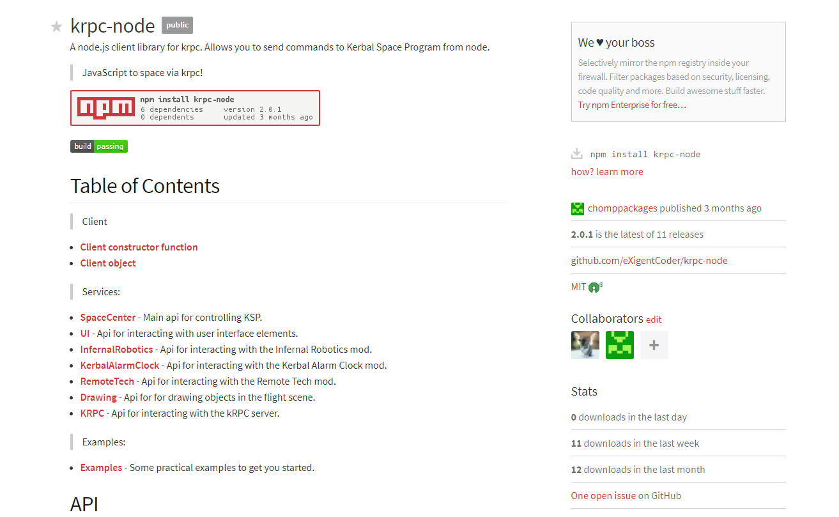

Slide 22
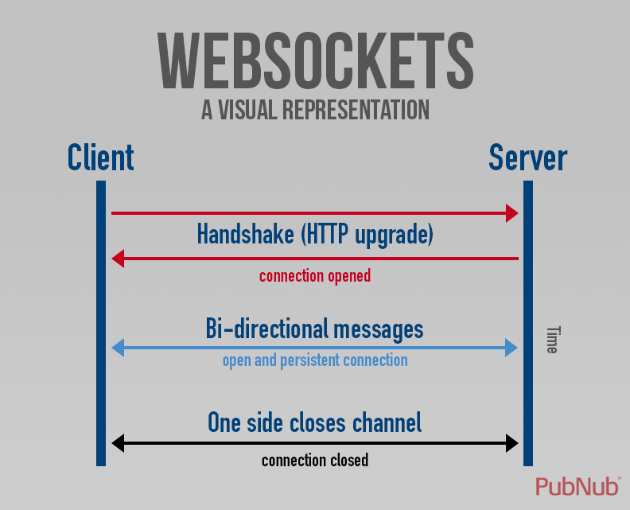
https://www.pubnub.com/blog/2013-09-11-what-are-websockets/

Slide 23

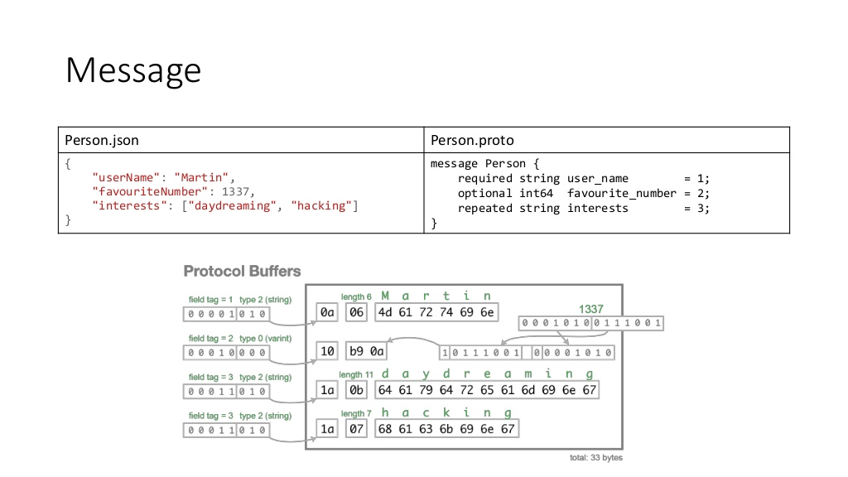
https://www.slideshare.net/SergeyPodolsky/google-protocol-buffers-56085699

Slide 24
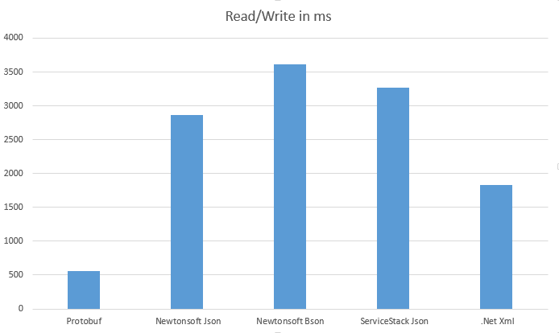
https://damienbod.com/2014/01/09/comparing-protobuf-json-bson-xml-with-net-for-file-streams/

Slide 25
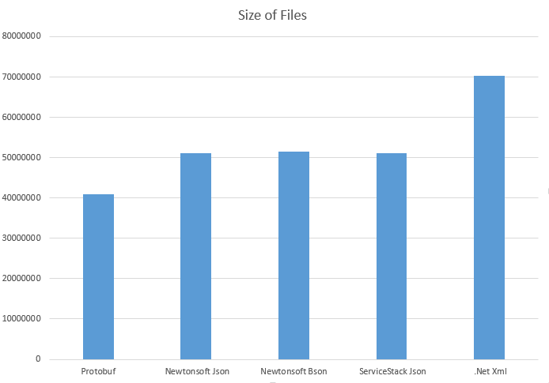

Slide 26
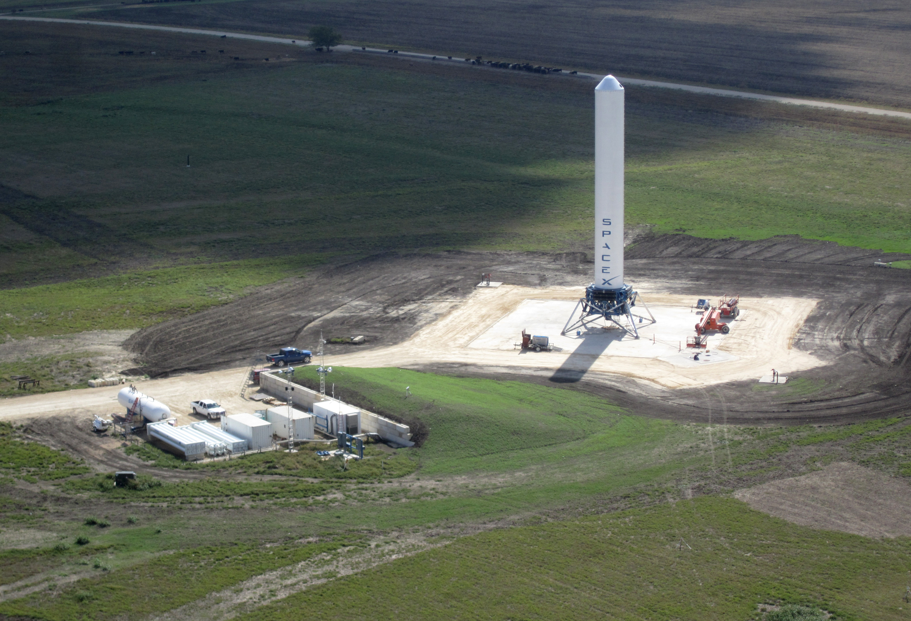
Notes:
For the first part of our demo, we wanted to reproduce some of the capabilities of SpaceX’s Grasshopper rocket which was the testbed for the Falcon9 and controlled landings.

Slide 27
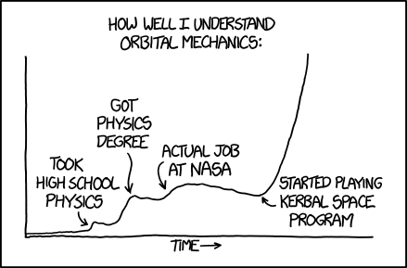

Slide 28
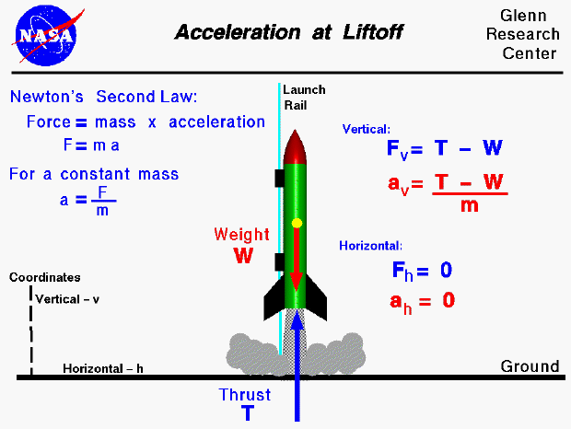
https://www.grc.nasa.gov/WWW/k-12/VirtualAero/BottleRocket/airplane/rktalo.html
Notes:
All 3 variables are constantly changing.
Gravity on ISS about 90% of what it is at sea level.
Astronauts float due to free-fall.

Slide 29
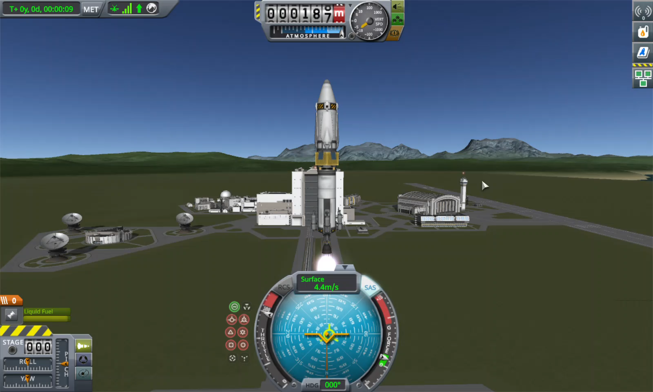
Notes:
Manual hovering

Slide 30

Notes:
There were some Technical difficulties

Slide 31
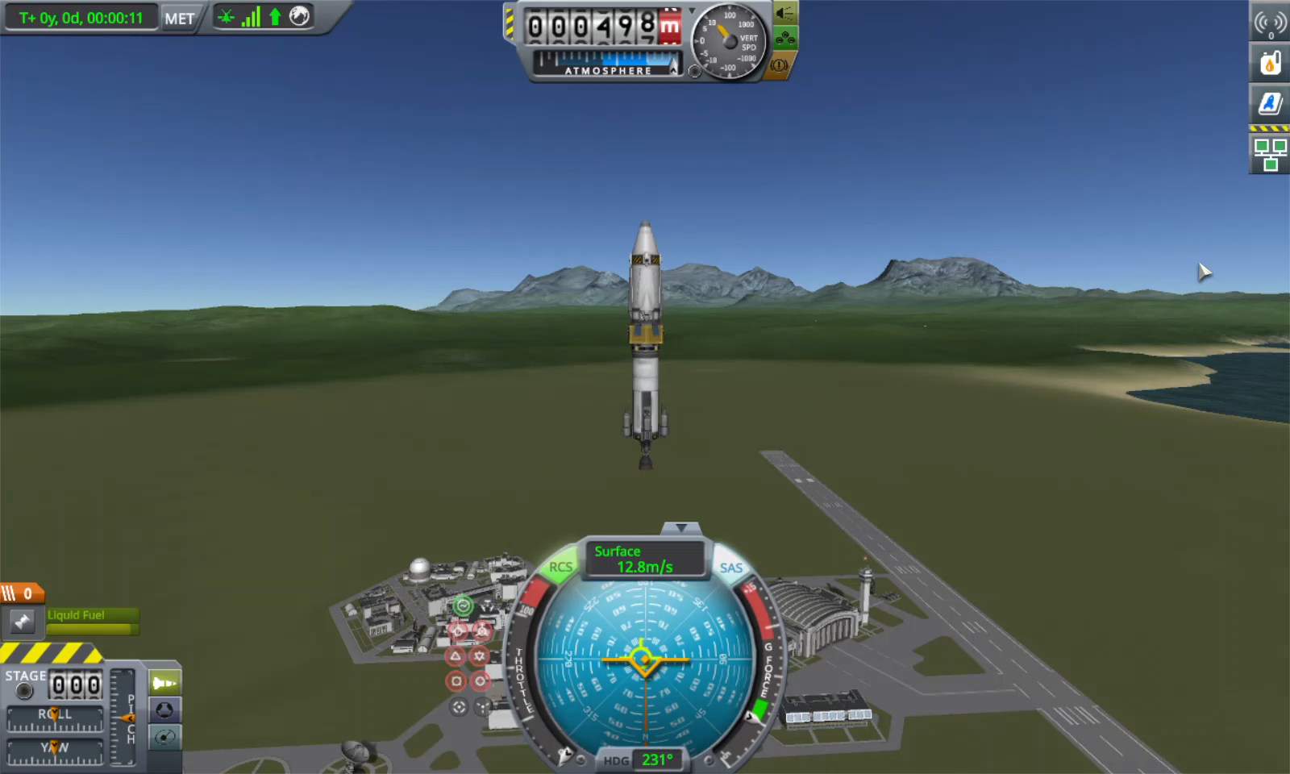
Notes:
Math based hovering

Slide 32
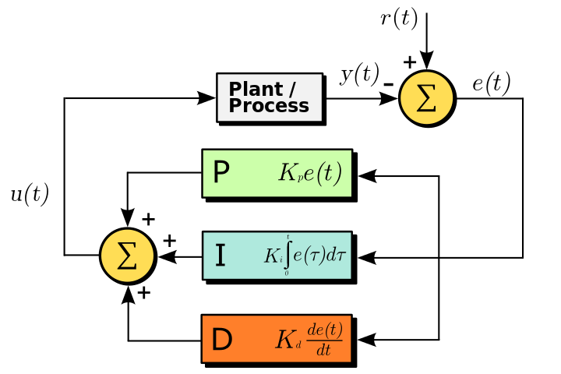
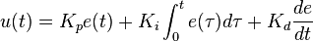

https://en.wikipedia.org/wiki/PID_controller
Notes:
proportional-integral-derivative controller
http://www.rentanadviser.com/en/pid-fuzzy-logic/pid-fuzzy-logic.aspx
Plug in 3 values to get the “error value” for a process value and desired set point.
P – Proportional present value
I – Integral past values (error accumulates over time)
D – Dirivitive – predicated future values based on current rate of change

Slide 33

Notes:
Demo Time

Slide 34
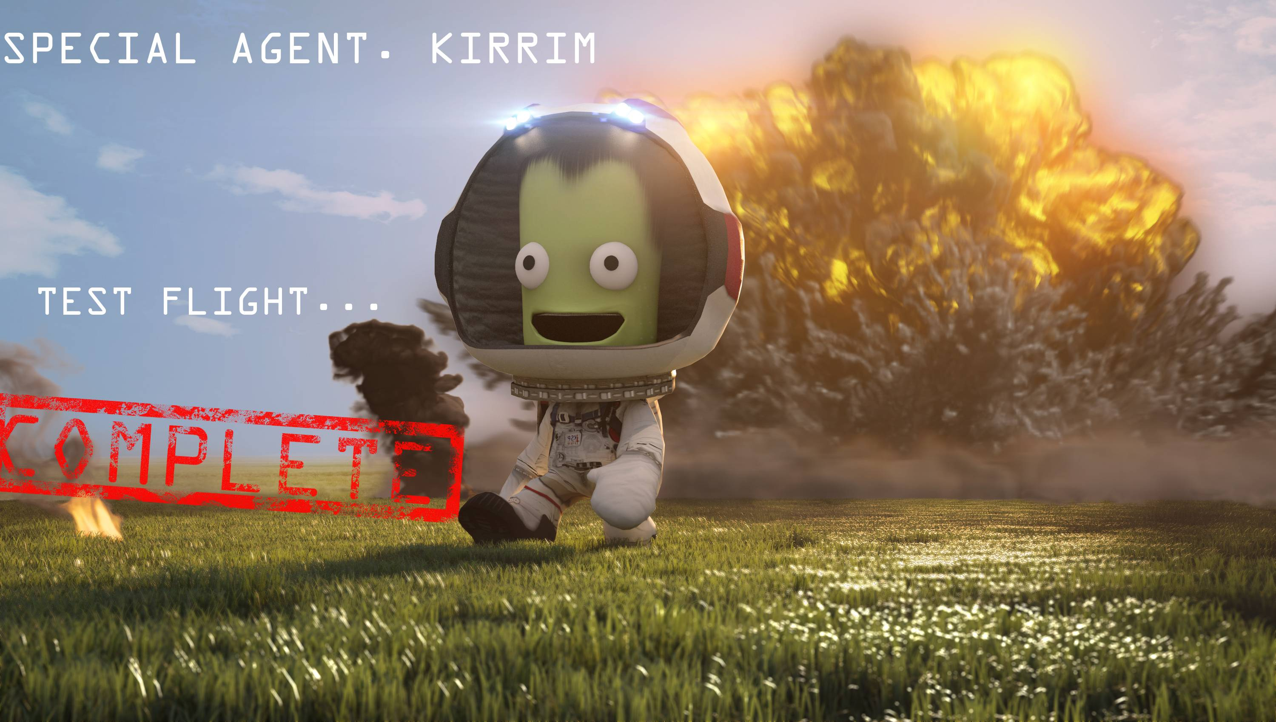
Notes:
Yay!

Slide 35
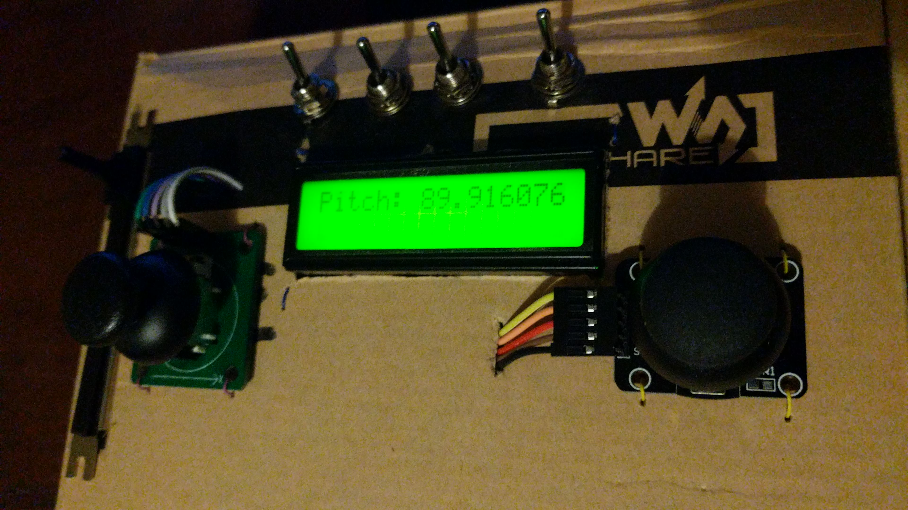

Slide 36
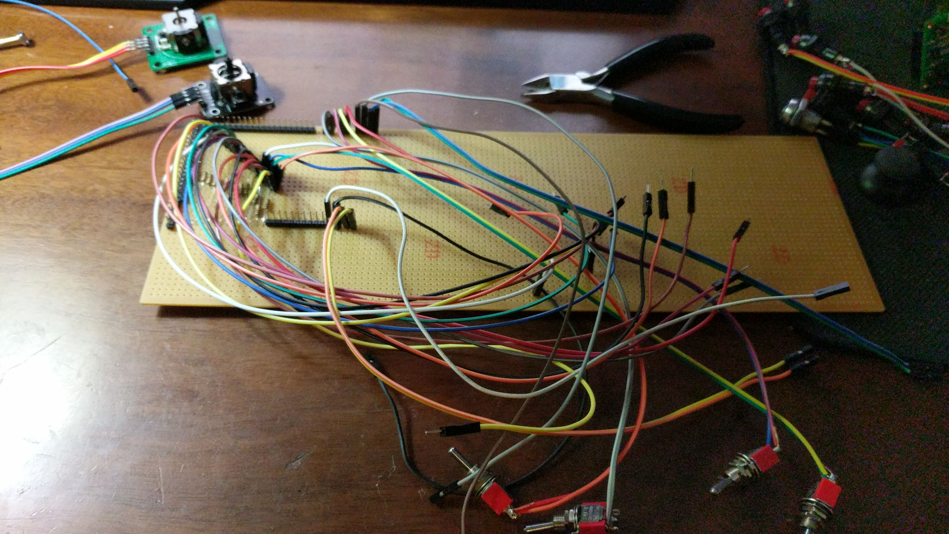

Slide 37
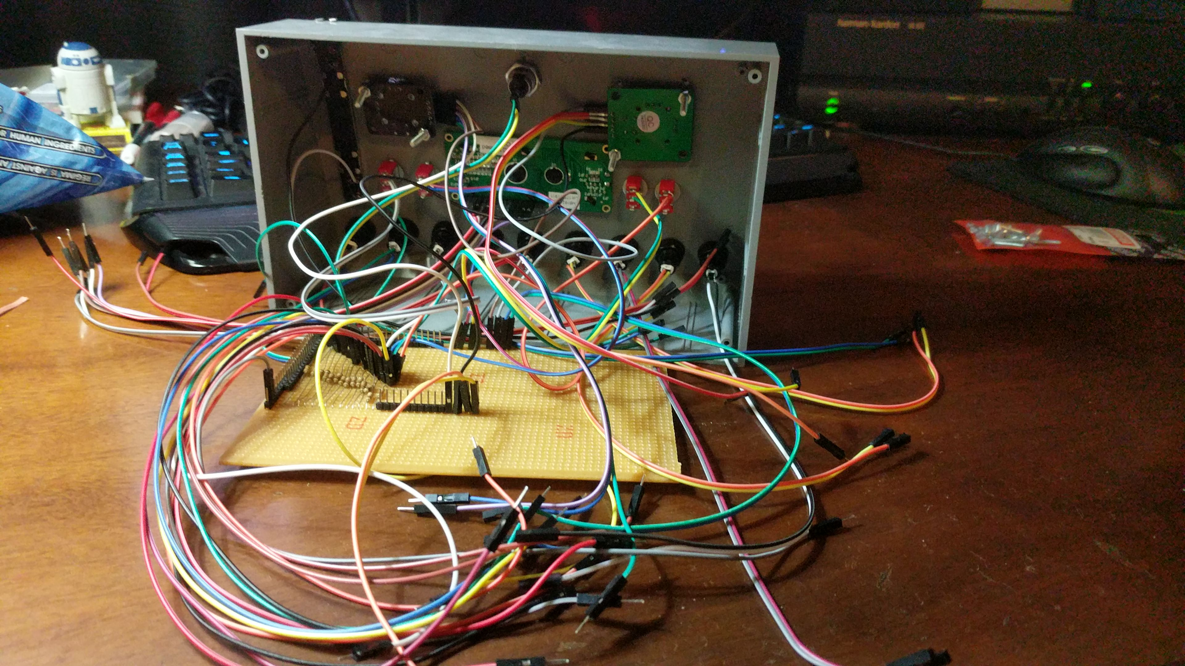

Slide 38
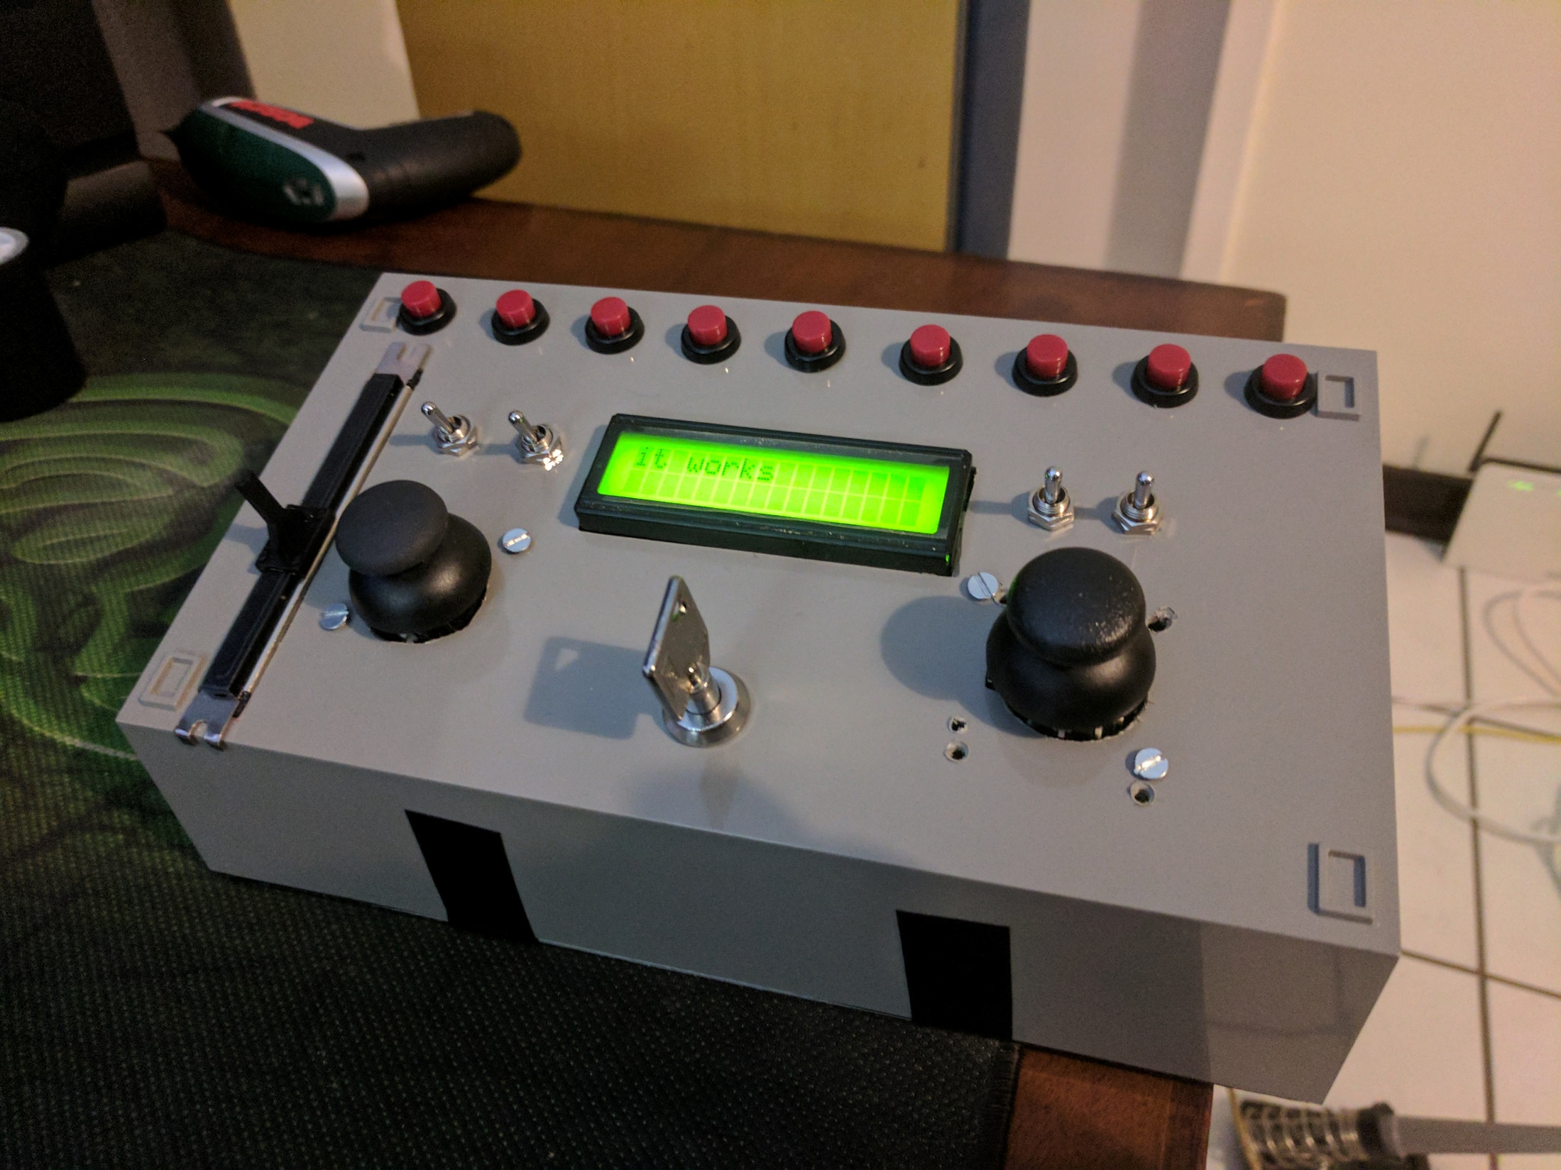

Slide 39

Notes:
Talk about future plan

Slide 40
Further Reading/Watching
https://www.youtube.com/user/szyzyg/playlists
https://krpc.github.io/krpc/
https://github.com/eXigentCoder/krpc-node

